Slide 1

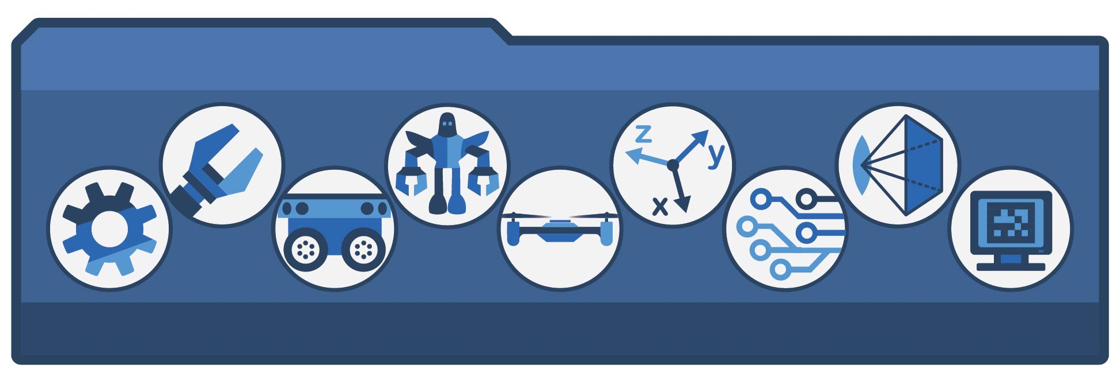
MACHINE LEARNING LAB
Pandas and MatplotLib
School of Electrical Engineering and Computer Science (SEECS), NUST, Pakistan

Slide 2
Pandas
Pandas (Panel Data) is a library used for loading, handling and cleaning datasets before feeding to a machine learning algorithm
Two data types: Series (column), Dataframe (table)
A simple column can be created using the Series type
import pandas as pd
B = [10, 2, 7]
serB = pd.Series(B)
print(serB)
print(serB[0])
serC = pd.Series(B, index = ["X", "Y", "Z"])
print(serC)
print(serC["Z"])

Slide 3
Pandas
Dictionaries can also be used to define Pandas series
import pandas as pd
D = {"Burger": 420, "Sandwich": 320, "Milkshake": 200}
serD = pd.Series(D)
print(serD)

Slide 4
Pandas Dataframe
Datasets can be stored in the Data Frame type in pandas
import pandas as pd
datasetA = {
'Company': ["Suzuki", "Toyota", "Ford", "Ford", "Suzuki"],
'Number': [9553, 4314, 2192, 8317, 2555],
'Color': ["White", "Black", "Black", "Red", "White"]}
dataframeA = pd.DataFrame(datasetA)
print(dataframeA)
print(dataframeA.loc[0]) # print row 0
print(dataframeA.loc[[0, 1, 4]]) # print rows 0, 1, 4
print(df.loc[0].at["x2"]) # print item in row 0, column x2

Slide 5
Pandas Dataframe
Serial numbers in a dataframe can be changed to descriptive names
df2 = pd.DataFrame(datasetA, index = ["day1","day2","day3"])
print(df2)
print(df2.loc["day2"])

Slide 6
CSV Dataframe
CSV tables can be loaded from disk into a dataframe
df3 = pd.read_csv(‘D:\\ML\\Lab4\\mydataset.csv')
The loaded dataset can be displayed:
To get the number of training examples in the dataset:
print(df3) # display first and last 5 rows
print(df3.head()) # display first 5 rows
print(df3.tail()) # display last 5 rows
print(df3.to_string()) # print entire table
print(df3.info()) # print table info
x1 = df3[‘column_name’].values.tolist() # get column in list
m = len(df3[‘column_name’].values.tolist())

Slide 7
Column Averages
At times, it is useful to calculate the average (mean, mode or median) of a specific column in the dataset
To calculate mean of a column in a dataset
To calculate mean of a column from a range of rows
To calculate mode of a column in a dataset
To calculate median of a column in a dataset
x = df[“x1"].mean()
x = df[“x1"][10:75].mean()
x = df[“x1"].mode()[0]
x = df[“x1"].median()

Slide 8
Dataset Cleaning
Datasets need to be cleaned of rows with empty cells, duplicated rows, data in wrong format
To remove rows with empty cells in the dataset
To replace empty cells with average value in the column
To remove duplicated rows from the dataset
df.dropna(inplace = True) # remove rows with empty cells
x = df[“x1"].mean()
df[“x1"].fillna(x, inplace = True)
df.drop_duplicates(inplace = True) # remove duplicate rows

Slide 9
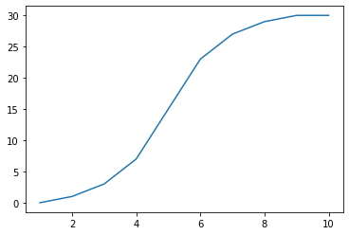
Plotting
For plotting, we can use the PyPlot submodule from the MatplotLib module
import matplotlib.pyplot as plt
time = np.array([1, 2, 3, 4, 5, 6, 7, 8, 9, 10])
speed = np.array([0, 1, 3, 7, 15, 23, 27, 29 ,30, 30])
plt.plot(time, speed)
plt.show()

Slide 10
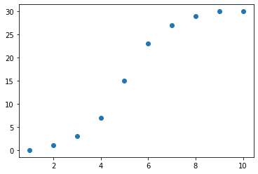
Plotting
import matplotlib.pyplot as plt
time = np.array([1, 2, 3, 4, 5, 6, 7, 8, 9, 10])
speed = np.array([0, 1, 3, 7, 15, 23, 27, 29 ,30, 30])
plt.scatter(time, speed)
plt.show()

Slide 11
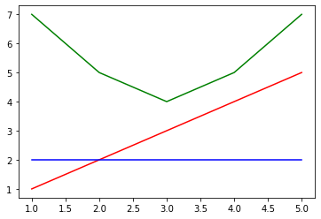
Plotting
Multiple plots can be made in the same graph
x = [1, 2, 3, 4, 5]
y1 = [1, 2, 3, 4, 5]
y2 = [2, 2, 2, 2, 2]
y3 = [7, 5, 4, 5, 7]
plt.plot(x, y1, 'r')
plt.plot(x, y2, 'b')
plt.plot(x, y3, 'g')
plt.show()

Slide 12
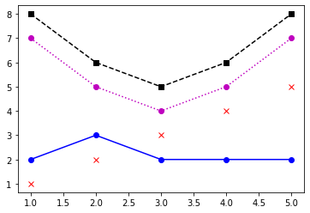
Plotting
Plots can be marked using a ‘marker line color’ string argument
x = [1, 2, 3, 4, 5]
y1 = [1, 2, 3, 4, 5]
y2 = [2, 3, 2, 2, 2]
y3 = [7, 5, 4, 5, 7]
y4 = [8, 6, 5, 6, 8]
plt.plot(x, y1, 'xr')
plt.plot(x, y2, 'o-b')
plt.plot(x, y3, 'o:m')
plt.plot(x, y4, 's--k')
plt.show()

Slide 13
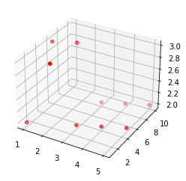
Plotting
3-D plots can also be implemented
x = [1, 2, 3, 4, 5, 1, 2, 3, 4, 5]
y1 = [1, 2, 3, 4, 5, 6, 7, 8, 9, 10]
y2 = [2, 3, 2, 2, 2, 3, 3, 2, 2, 2]
ax = plt.axes(projection ="3d")
ax.scatter3D(x, y1, y2, color = "r")
plt.show()

Slide 14
Lab Tasks
Download the Lab Material
Perform the Lab Tasks given in the manual
Submit the saved manual in PDF form
Remember to delete your manual after completing the lab session

